Slide 1
Gender Equity in College Sports
Emily Caraher, Cassandre Korvink,
Connor Therrien, Julie Zhu, Radha Pawar
Notes:
Cass
Who here follows college sports
Keep your hand up if you follow women’s college sports

Slide 2
Participation and Title IX
Title IX of the Education Amendments of 1972
Equal opportunity for participation in collegiate athletics
Scholarships proportional to participation
Equal access to facilities and resources (i.e. equipment, medical, travel, etc.)
UT Men’s Varsity Sports:
(1893) football, (1894) baseball, (1895) track & field/cross country, (1906) basketball, (1912) tennis, (1926) swimming and diving, (1927) golf
UT Women’s Varsity Sports:
(1974-75) basketball, golf, swimming and diving, track & field/cross country, volleyball
(1979) tennis, (1994) soccer, (1997) softball, (1998) rowing, (2024) beach volleyball
NACDA Learfield Directors' Cup (Division 1)
Notes:
Cass
Directors - ‘20, ‘21, ‘23, ‘24 -> second to stanford in wins, more points for a higher finish

Slide 3
Problem
Women’s sports are significantly lower in revenue and expenditure. The effects can be seen with the lower levels of participation.
How can a balance between male and female participation in collegiate athletics be reached?
Notes:
Cass
How does male and female sports participation differ across U.S. colleges, and how do these differences vary by state, region, institution type, and over time

Slide 4
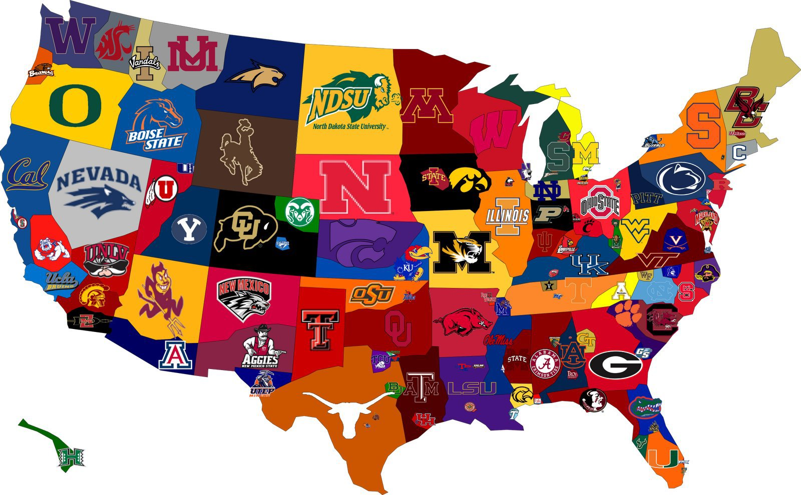
Data Overview
College Sports Data (2015-2019):
2212 Schools
38 Sports
Revenues
Expenditures
Participation
Classification
State
Region
Notes:
Connor

Slide 5
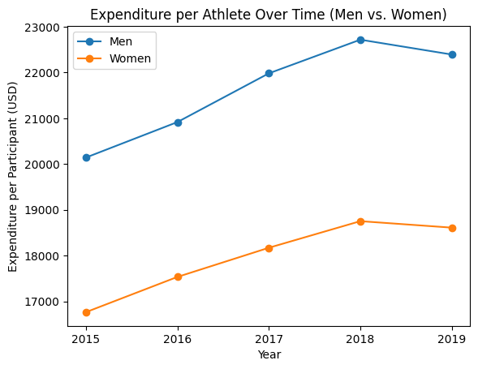
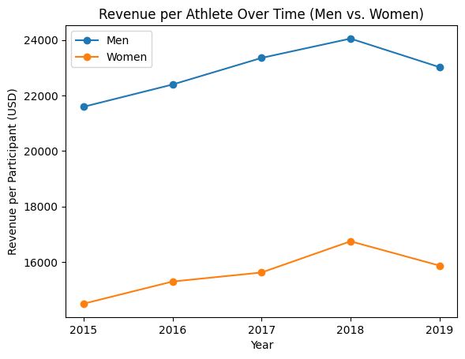
Revenues and Expenditures
Notes:
Connor - Visual Representation of drastic differences between the expenditures on male + female sports, along with the revenues that they generate. This reinforces the stated problem. One thing I’d like to point out is that female participants had the largest jump in revenue YoY between 2017 and 2018, with over $1100 on a per athlete basis. This shows promise to us, that there’s room to grow revenues in female college sports

Slide 6
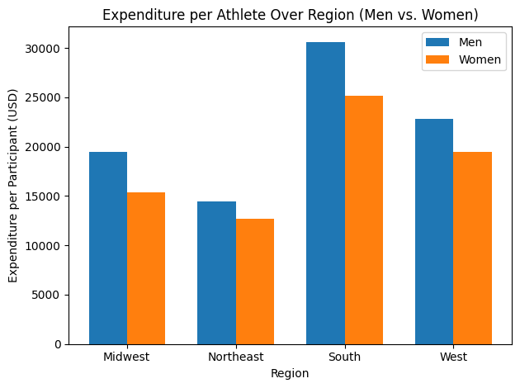
Revenues and Expenditures
Notes:
Connor

Slide 7
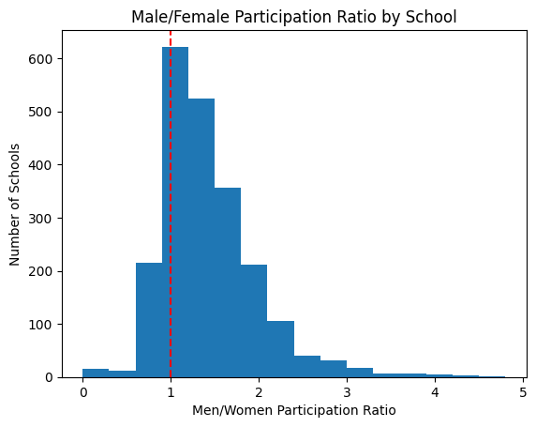
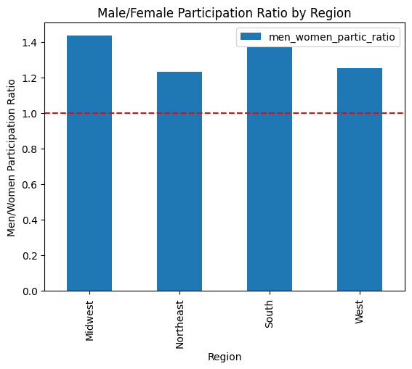
Male/Female Participation Ratios
Notes:
Emily
How gender participation differs across colleges at the school level and by region
Majority of schools have more male athletes than female, red line is perfect gender parity and most schools above this line
Right graph has data aggregated by region, same red line at 1 meaning equal participation, South and Midwest have highest ratios with all still above 1
Widespread gender disparities across schools and regions, likely because of differences in Title IX state-level enforcement

Slide 8
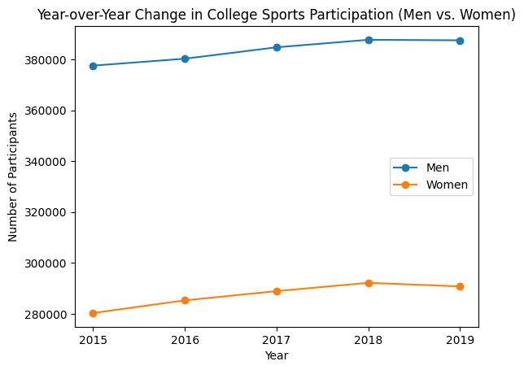
Participation over Time
Notes:
Emily
year-over-year change in college sports participation from 2015-2019, comparing men and women
Growth but males higher
Slightly steeper growth rate for women
Slight decline in 2019 for both which could be related to budget cuts or Title IX compliance adjustments
Still significant gap

Slide 9
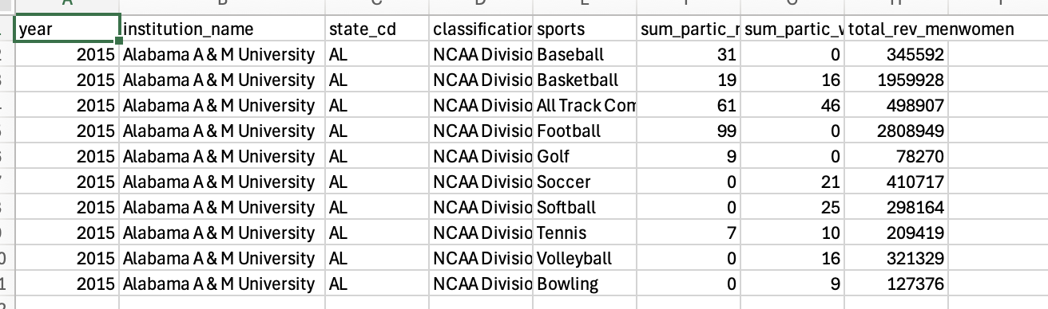
Key Variables
Male & female participation counts
Institution classification (Division I, II, III, etc.)
Sport type
Year
Revenue
Notes:
Julie

Slide 10
Regression Approach
Goal: Predict total athletics revenue per school year
Model A
Numeric only (Male/Female participation, year)
R sqrd = 0.079
RMSE ≈ $3.52M
Model B
Numeric + categorical (division, sport type)
R sqrd = 0.213
RMSE ≈ $3.26M
*This suggests that understanding institutional structure and sport offerings is essential for modeling athletics revenue.
Notes:
Julie
Participation counts alone poorly explain revenue variation Division and sport type are strong structural drivers of revenue

Slide 11
Conclusion
Average women’s participation share ~ 42.8%
Average women’s revenue share ~ 27.8%
Average women’s expense share ~ 35.8%
It’s clear that women’s participation in college sports is getting close to parity with men’s — but when it comes to investments, revenues, and overall financial support, there’s still a noticeable gap to close.
Notes:
Radha -
Women make up around 43% of college athletes, which is pretty close to parity with men. But when we look at the financial side, it’s a different story - women’s programs bring in only about 28% of the revenue and get roughly 36% of the expenses.
That gap means men’s programs still get more resources, better facilities, and more exposure, while women’s teams often have to do more with less.
So the big takeaway here is that participation equity is good progress, but it’s not the full picture. For real change, we need equity in investment, revenue, and overall funding too

Slide 12
Solution
Generate revenue
Exposure: ESPN, broadcasting, social media
Booster Organizations
NIL (Name, Image, Likeness)
Targeted investments in underfunded women’s sports
Redirect the funding to be equivalent between genders.
Fairer per athlete spending.
Advertise to younger athletes
Youth and community integration
Notes:
Radha
Here’s what we can do to close this Gap:
We can boost revenue for women’s sports by increasing their exposure - getting more games on ESPN or local broadcasts, using social media campaigns, and also taking advantage of NIL deals for athletes.
we need targeted investments - while making sure budgets are split more fairly and that per-athlete spending is balanced.
we can start younger - run campaigns in schools to inspire future female athletes.
And finally, bring the community in — host events, workshops, and partnerships so women’s teams build a strong local fan base.
Here we’re not just talking about equal participation — we’re moving toward true financial equity in college sports.

